Slide 1

Network Layer I: roadmap
IPv4 & Addressing
IPv4 datagram format
IPv4 addressing
IPv6

Slide 2
IPv6: motivation
initial motivation: 32-bit IPv4 address space would be completely allocated
additional motivation:
speed processing/forwarding: 40-byte fixed length header
enable different network-layer treatment of “flows”
最初的动机:32位IPv4地址空间将被完全分配
额外的动机:．快速处理/转发:40字节固定长度的报头
支持不同的网络层处理“流”

Slide 3
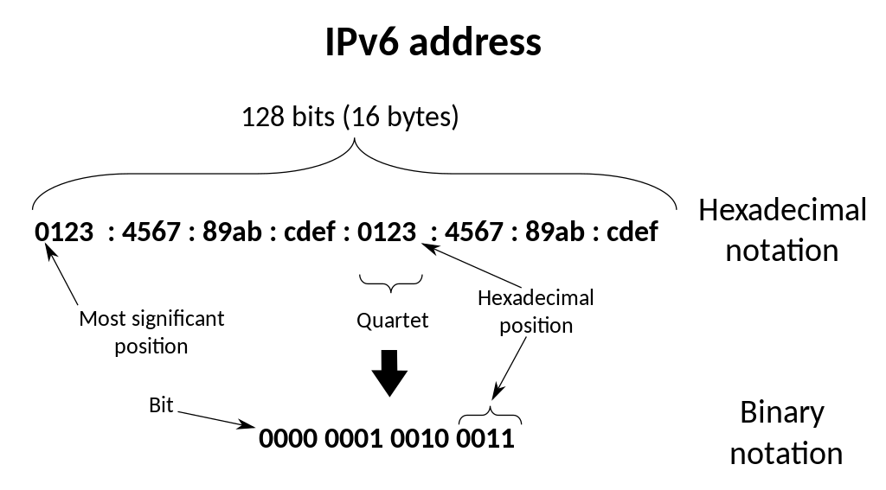
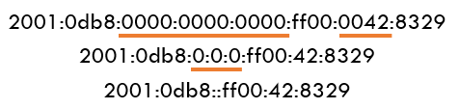
IPv6
IPv6, first introduced in 1998
Address format
128-bit addresses
eight groups of four hexadecimal digits, separated by colons ‘:’
Leading zeros in each group may be omitted and groups of zeros can be omitted using ‘::’
128位地址
八组四个十六进制数字，用冒号':'隔开
By Michel Bakni

Slide 4
IPv6 datagram format
flow label: identify datagrams in same "flow.” (concept of “flow” not well defined).
32 bits
priority: identify priority among datagrams in flow
ver
pri
flow label
payload len
next hdr
hop limit
source address
(128 bits)
128-bit
IPv6 addresses
destination address
(128 bits)
payload (data)
What’s missing (compared with IPv4):
no checksum (to speed processing at routers)
no fragmentation/reassembly
no options (the removal of options filed results in a fixed-length, 40-byte IP header)
(与IPv4相比)缺少什么:
没有校验和(以加快路由器的处理速度)
没有分裂/重新组装
无选项(删除选项字段会产生固定长度的40字节IP头)

Slide 5
Transition from IPv4 to IPv6
not all routers can be upgraded simultaneously
no “flag days”
how will network operate with mixed IPv4 and IPv6 routers?
tunneling: IPv6 datagram carried as payload in IPv4 datagram among IPv4 routers (“packet within a packet”)
E隧道:IPv6数据报作为IPv4数据报的有效载荷在IPv4路由器之间被携带(“包中包”)
IPv4 header fields
IPv6 header fields
IPv4 payload
IPv4 source, dest addr
IPv6 source dest addr
UDP/TCP payload
IPv6 datagram
IPv4 datagram

Slide 6
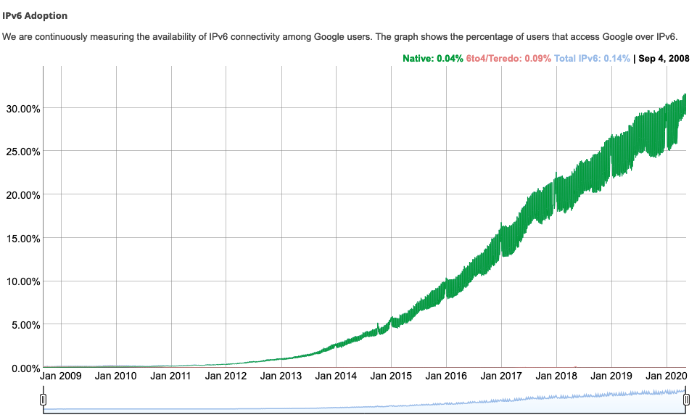
IPv6: adoption
Google¹: ~ 30% of clients access services via IPv6
NIST: 1/3 of all US government domains are IPv6 capable
¹ https://www.google.com/intl/en/ipv6/statistics.html

Slide 7
Thank You!

